Slide 1
Computer Controlled Systems
Week 11 — Lecture 21 & 22
Robotics in Manufacturing · Production Line Control · Autonomous Vehicles
Advantages & Disadvantages of Computer-Controlled Systems

Slide 2
Contents
01
Introduction to Computer Controlled Systems
02
Robotics in Manufacturing
03
Production Line Control
04
Autonomous Vehicles
05
Advantages & Disadvantages of CCS
02

Slide 3
Introduction to Computer Controlled Systems
01
Understanding the fundamentals of CCS and their role in modern industry

Slide 4
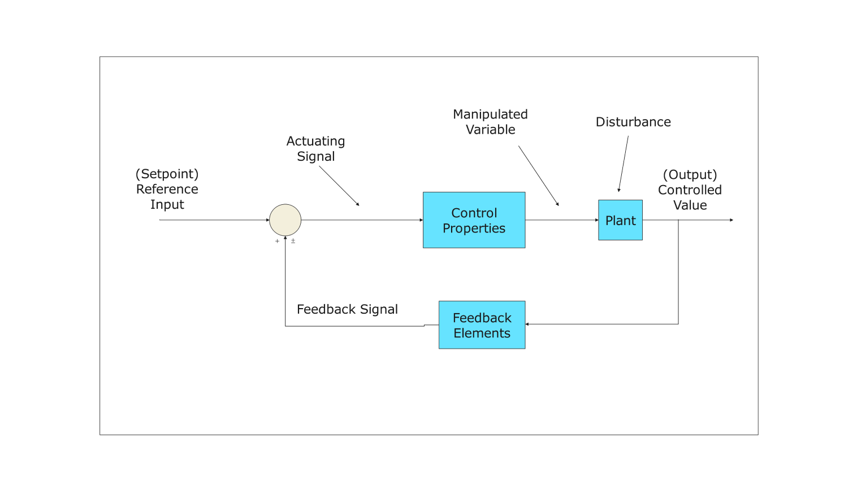
What are Computer Controlled Systems?
Definition
A Computer Controlled System (CCS) is a system where a computer or microprocessor manages, directs, or regulates the behavior of other devices using control loops and algorithms.
Key Characteristics
• Automated decision-making, real-time processing
• Precision control with feedback loops
Real-World Examples
• CNC machines, traffic systems, smart homes
Closed-Loop Control System Block Diagram
Hierarchy of CCS
CCS → Industrial Control → Embedded Systems → Robotics → Autonomous Systems
Sensors (Input)
Controller
Actuators (Output)
← Feedback Loop
04

Slide 5
Types of Computer Controlled Systems
Open-Loop Systems
Closed-Loop Systems
Sub-Types
• No feedback mechanism
• Output has no effect on control
• Simple but less accurate
Example:
Washing machine timer
• Uses feedback to adjust output
• Compares with desired input
• More accurate and stable
Example:
Thermostat, cruise control
• Linear Control
• Non-Linear Control
• Time-Invariant
• Time-Variant
• Digital vs Analog
Comparison: Open-Loop vs Closed-Loop
Feature | Open-Loop | Closed-Loop
Feedback | None | Continuous feedback
Accuracy | Lower | Higher
Complexity | Simple, low cost | Complex, higher cost
05

Slide 6
Key Components of a CCS
Sensors
Controller
Actuators
Network
Detect physical quantities and convert to electrical signals
Ex: Thermocouples, LIDAR
The "brain" — processes input and makes decisions
Ex: Arduino, PLC, Raspberry Pi
Convert electrical signals to physical action
Ex: Motors, Servo Valves
Connects all components for data exchange
Ex: Fieldbus, Ethernet/IP
System Flow Diagram
Input (Sensors)
Controller
Output (Actuators)
Feedback Loop
06

Slide 7
02
Robotics in Manufacturing
How robotic systems transform modern manufacturing processes

Slide 8
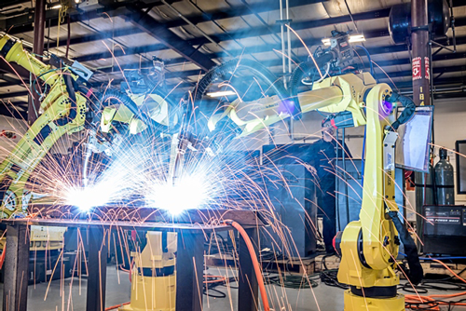
Robotics in Manufacturing — Overview
Definition
Industrial robotics refers to programmable, multi-functional manipulators designed to move materials, parts, or tools through programmed motions.
Key Applications
• Welding, painting, assembly, packaging
• Quality inspection, material handling
Major Manufacturers
• FANUC (Japan), ABB (Switzerland)
• KUKA (Germany), Universal Robots
• Universal Robots (Denmark)
$43.8B
$81.4B
Market Value (2024)
Projected (2030)
08

Slide 9
Types of Industrial Robots
Articulated Robots
SCARA Robots
Cartesian / Gantry
• Multiple rotary joints (like a human arm)
• 6-axis most common
• Used for welding, assembly
Ex: FANUC M-20iD
• 4-axis, fast and precise
• Selective Compliance
• Pick-and-place, dispensing
Ex: Epson T-Series
• Linear motion in X, Y, Z
• High precision positioning
• CNC, 3D printing
Ex: Bosch Rexroth
Delta Robots
Collaborative (Cobots)
Cylindrical & Polar
• Parallel kinematic structure
• Extremely fast movement
• Packaging, sorting
Ex: ABB FlexPicker
• Work safely alongside humans
• Force-limiting sensors
• Easy programming
Ex: Universal Robots UR10e
• Rotary + linear motion
• Simple loading/unloading
• Cost-effective for basic tasks
Ex: FANUC M-710iC
09

Slide 10
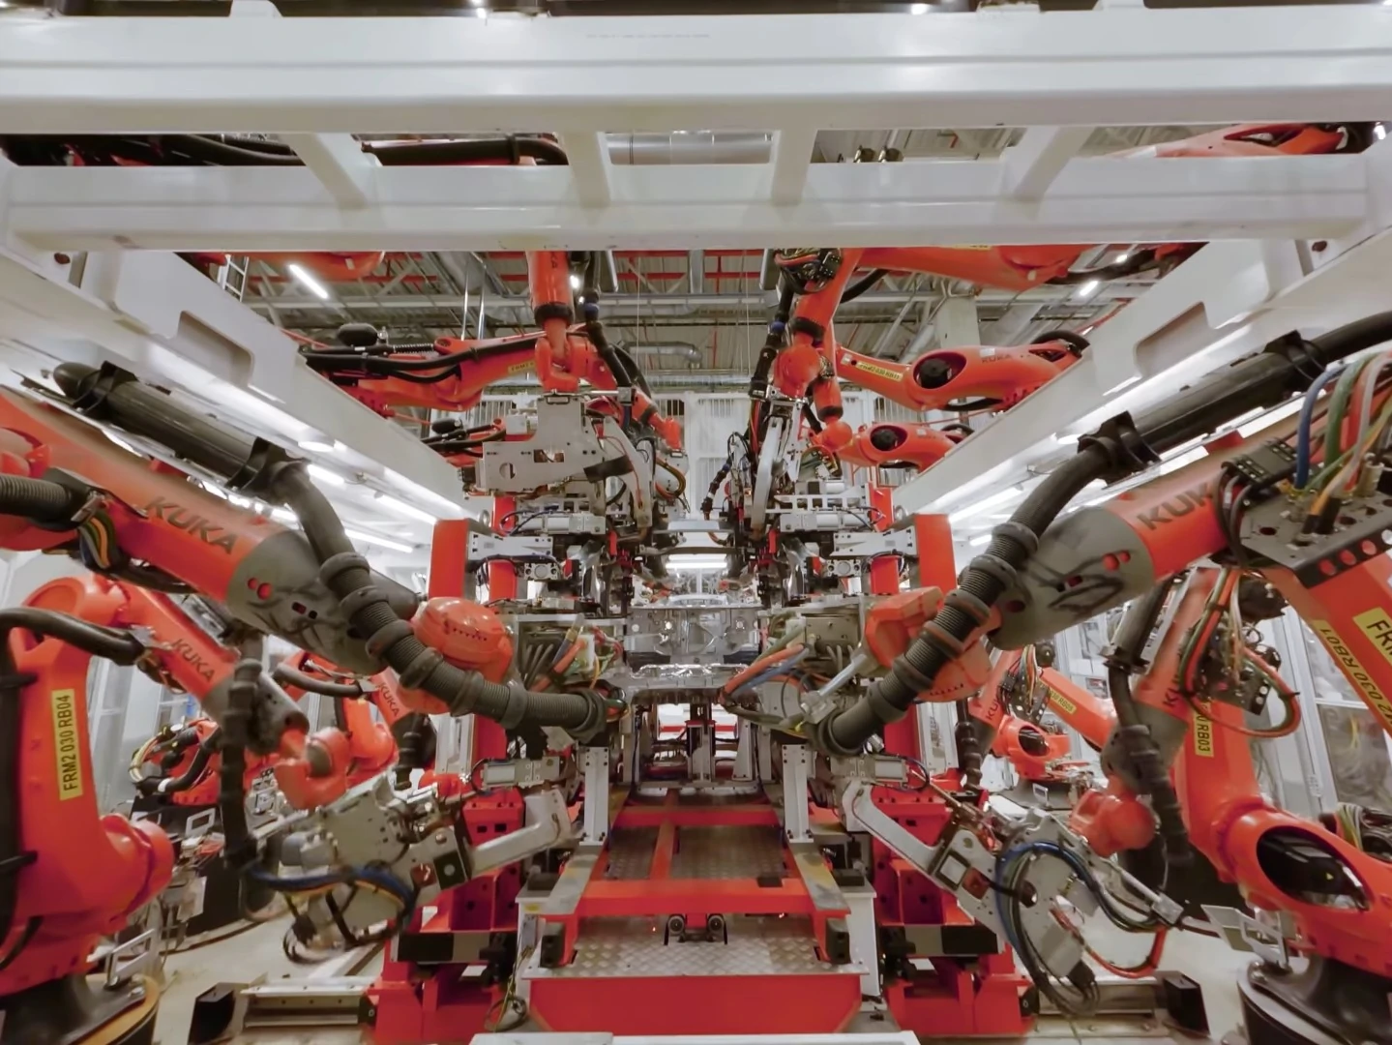
Real-World Examples — Robotics in Action
Tesla Gigafactory
• 1,500+ KUKA and FANUC robots per factory
• One car produced every 30 seconds
Amazon Fulfillment
• 750,000+ Kiva robots move inventory
• Order processing time reduced by 50%
BMW Spartanburg
Foxconn (Apple)
Da Vinci Surgical
• 2,500+ robots in largest BMW factory
• ABB robots with 0.1mm precision
• Spot welding on car bodies
• "Lights-out" factories
• 30,000+ Foxbots for iPhone assembly
• 100% robotic production lines
• 7 degrees of freedom
• 10+ million surgeries worldwide
• Minimally invasive procedures
10

Slide 11
Benefits of Robotics in Manufacturing
±0.02mm
24/7
72%
12-24 Mo
Robot Precision
Continuous Operation
Injury Reduction
Typical ROI Period
Key Advantages
• Precision & Consistency: Zero fatigue-related errors
• Speed & Productivity: 3-5x faster than humans
• Safety: Handles hazardous environments
• Quality: Defect rates reduced by 80-95%
• Data: Every action logged for optimization
• Cost: 1 robot = 3-5 human workers
11

Slide 12
03
Production Line Control
Systems and technologies that manage automated production lines

Slide 13
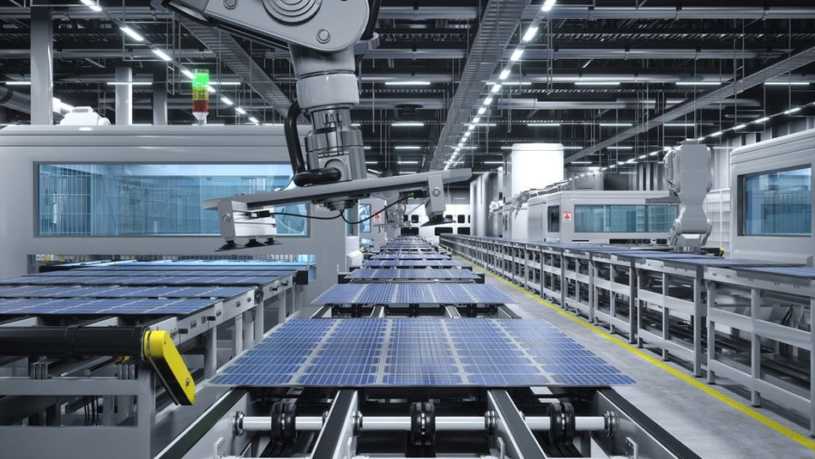
Production Line Control — Overview
Definition
Production line control refers to the computerized management of manufacturing processes where materials move through sequential workstations.
Key Objectives
• Maximize throughput, minimize downtime
• Ensure quality, optimize resources, enable traceability
Evolution of Production Control
1913
1960s
1970s
1990s
2010s+
Manual Assembly
Ford Model T
Relay Automation
Hard-wired logic
PLC Control
Programmable logic
DCS / SCADA
Integrated systems
Industry 4.0
Smart Manufacturing
13

Slide 14
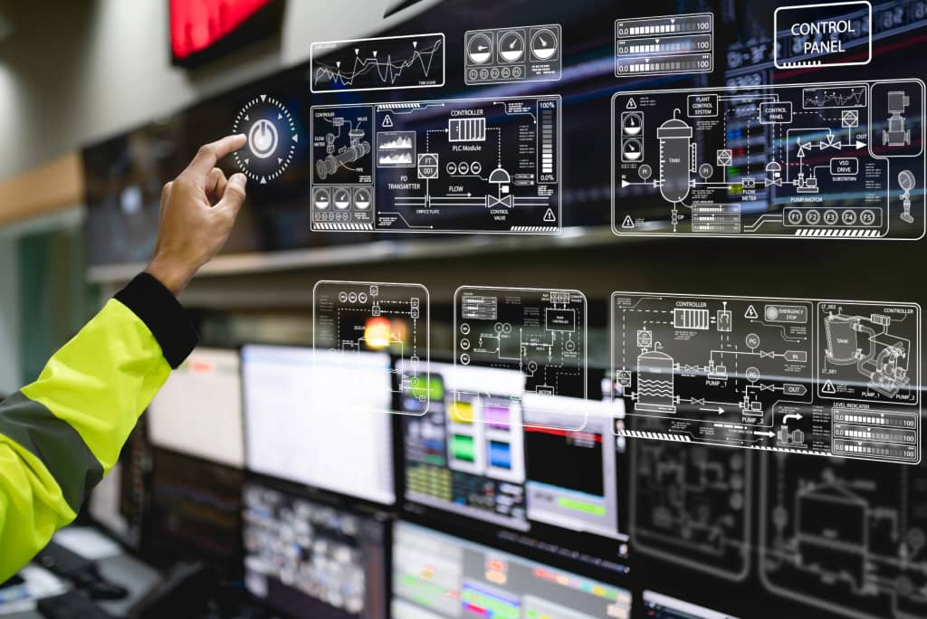
Types of Production Line Control Systems
PLC vs DCS vs SCADA
PLC
Rugged, real-time industrial computer for automation
Ex: Siemens S7-1500, Allen-Bradley ControlLogix
Feature | PLC | DCS | SCADA
Scale | Small-Medium | Large | Very Large
Speed | Real-time (ms) | Fast (100ms) | Variable (s)
Industry | Manufacturing | Oil, Chemical | Utilities, Water
Cost | Low-Medium | High | Medium-High
DCS
Large-scale control with distributed controllers
Ex: Honeywell Experion, Yokogawa CENTUM
SCADA
Centralized monitoring of dispersed systems
Ex: Wonderware, Ignition, WinCC
HMI
Touchscreen panels for operator interaction
14

Slide 15
PLC Programming — Ladder Logic Example
What is Ladder Logic?
Graphical language for PLCs. Resembles relay circuits with rungs and rails.
Common Instructions
• XIC — Examine If Closed • XIO — Examine If Open
• OTE — Output Energize • TON — Timer On-Delay
● ● ●
conveyor_belt_control.ld
// Conveyor Belt Motor Control
Rung 1: Motor Start/Stop Latch
|--[ START_SW ]--+--[/STOP_SW /]--(MOTOR)--|
| +--[ MOTOR ]----------------|
Rung 2: Overload Protection Timer
|--[ MOTOR ]--+--[TON T1 10s]--(ALARM)--|
Modern PLC Programming Languages (IEC 61131-3)
Ladder Diagram
(LD) — Most popular
Structured Text
(ST) — Pascal-like
Function Block
(FBD) — Graphical
Sequential Func
(SFC) — State-based
Instruction List
(IL) — Assembly-like
A bottling plant PLC controls 500+ bottles/minute with 99.97% accuracy
15

Slide 16
SCADA Systems & Applications
SCADA Architecture
Field Devices
RTU / PLC
Comm Network
SCADA Server
Key Functions
HMI Workstation
• Real-time monitoring & alarm management
• Historical data logging & report generation
• Remote control of geographically dispersed systems
Water Treatment
Oil & Gas
Power Grid
Thames Water (UK)
• 350 treatment plants
• 30,000 km of pipes
• 15 million customers
Shell Offshore
• 3,000+ wells monitored
• Real-time pressure & temp
• Remote flow control
National Grid (UK)
• 25,000 km of lines controlled
• Real-time load balancing
• Automatic fault detection
Security Alert: Stuxnet worm (2010) targeted SCADA systems, causing $1B+ in damages. Ransomware attacks on factories increased 156% in 2023.
16

Slide 17
04
Autonomous Vehicles
Self-driving technology and its levels, types, and real-world applications

Slide 18
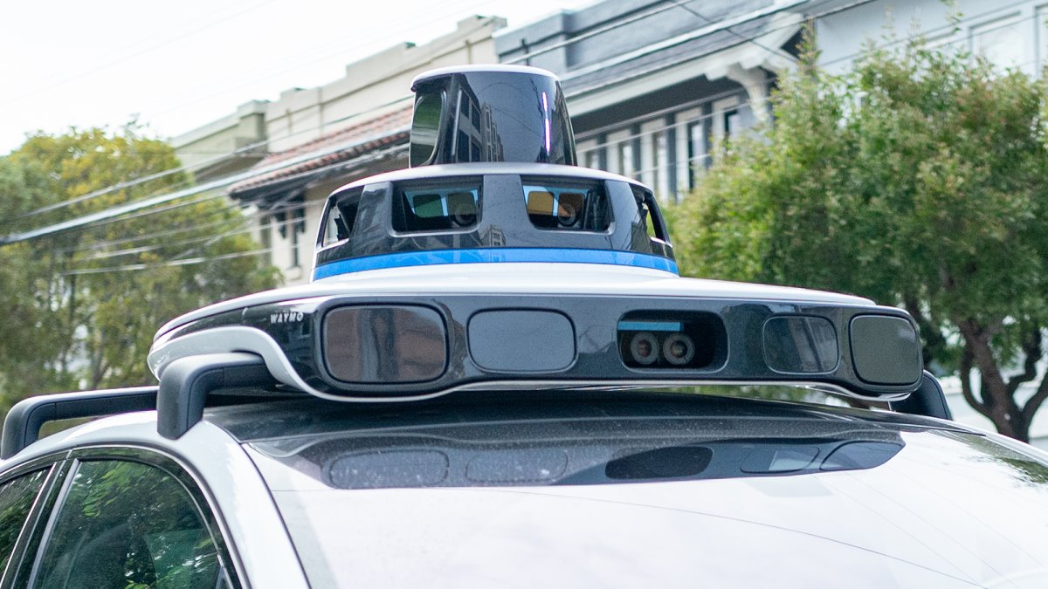
Autonomous Vehicles — Definition & Overview
Definition
An autonomous vehicle (AV) senses its environment and operates without human involvement.
Core Technologies
• Computer vision, LIDAR, RADAR, GPS/IMU
• Sensor fusion, machine learning, path planning
Key Players
• Tesla, Waymo, Cruise, Baidu Apollo, Mobileye
$2.3 Trillion
33 Million
SAE J3016
Expected AV Market by 2030
Autonomous Vehicles on Roads (2030)
6-Level Autonomy Classification
18

Slide 19
Levels of Vehicle Autonomy (SAE J3016)
Level 0
Level 1
Level 2
Level 3
Level 4
Level 5
No Automation
Assistance
Partial
Conditional
High
Full
Human does everything
Ex: Traditional manual cars
Single function automated
Ex: Cruise control
Combined auto functions. Driver must monitor
Ex: Tesla Autopilot
Vehicle handles most driving. Human must be ready
Ex: Mercedes Drive Pilot
Fully autonomous in specific areas (geofenced)
Ex: Waymo One
Complete autonomy in all conditions. No wheel needed
Expected 2030+
19

Slide 20
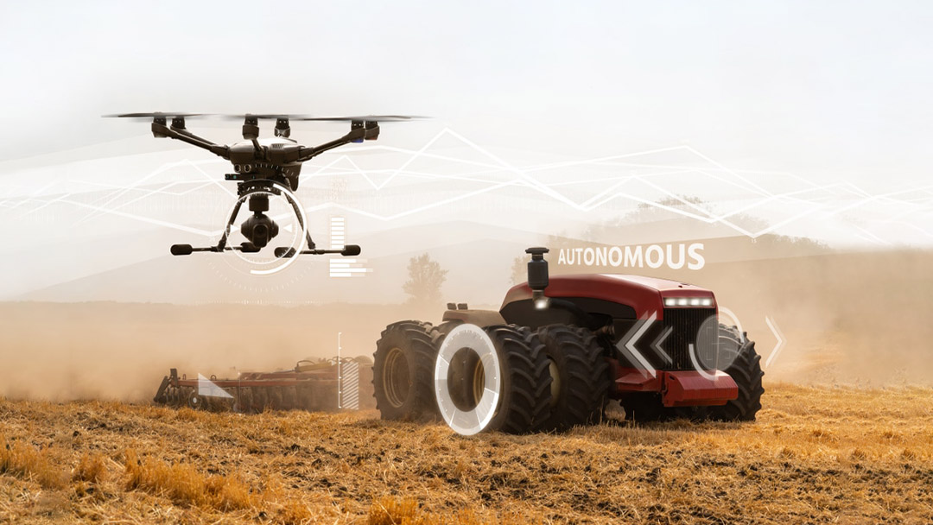
Types of Autonomous Vehicles
Autonomous Cars
Autonomous Trucks
Delivery Drones
Passenger vehicles with self-driving capability
Ex: Tesla Model S, Waymo I-PACE
Long-haul freight without drivers. Reduce costs by 45%
Ex: TuSimple, Aurora
Last-mile autonomous delivery
Ex: Amazon Prime Air
Starship Technologies
Autonomous Buses
Agricultural AVs
Maritime & UAVs
Public transport automation. Operating in 30+ countries
Ex: Navya, EasyMile
Self-driving tractors and harvesters
Ex: John Deere 8R
Fendt Xaver swarming robots
Self-navigating ships & aerial drones
Ex: Yara Birkeland ship
DJI Matrice, Wing drones
20

Slide 21
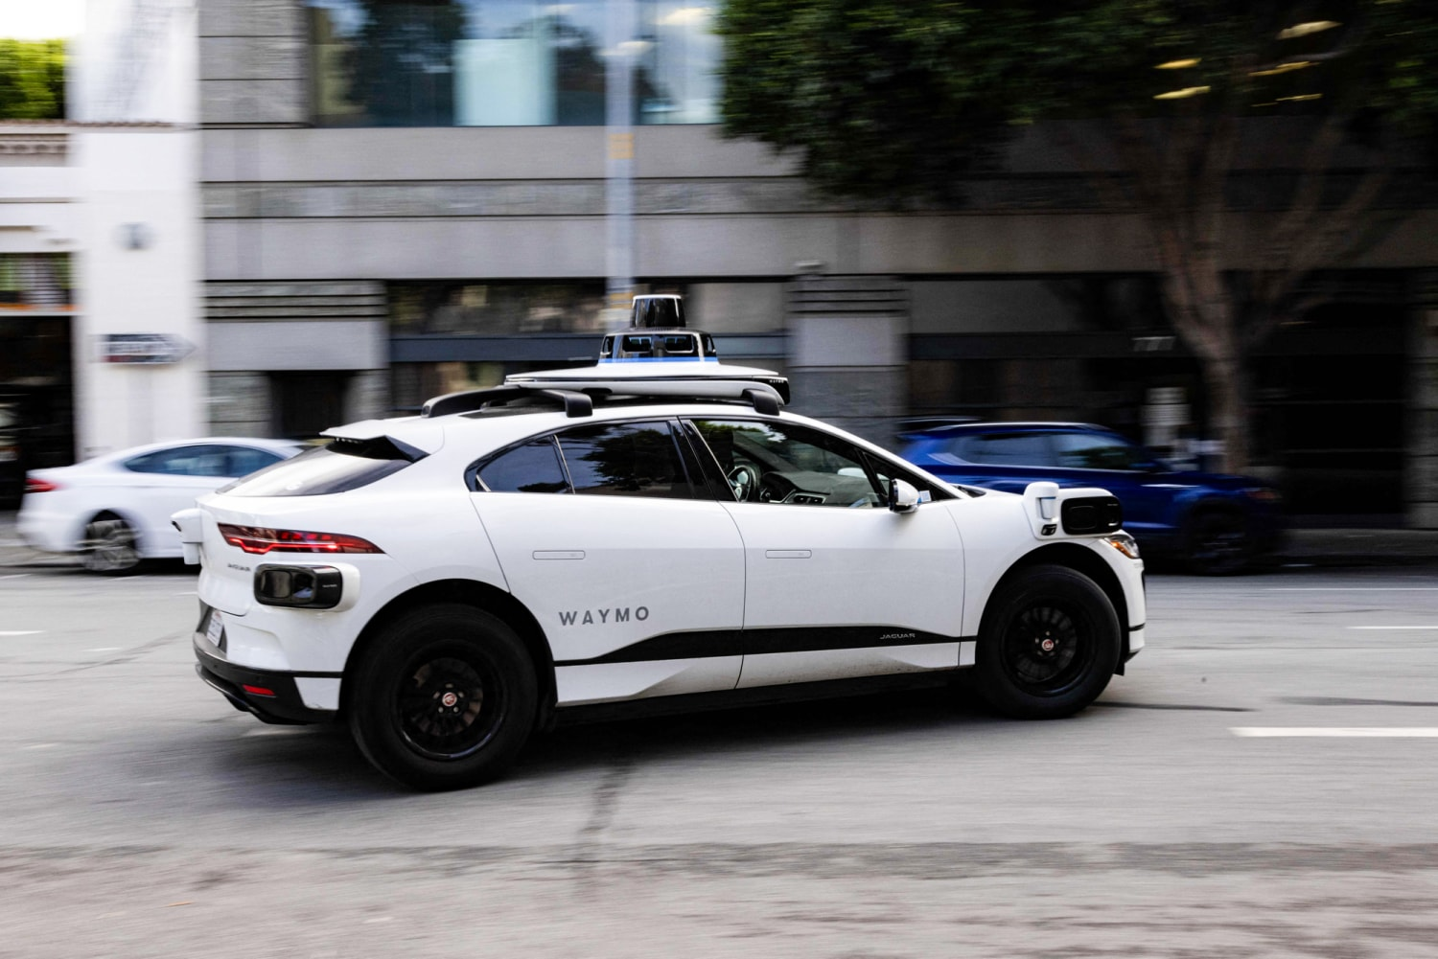
Real-World Applications of Autonomous Vehicles
Waymo One — World's first commercial robotaxi
• 100,000+ weekly rides (2024)
• Phoenix, AZ & San Francisco, CA
• Zero at-fault accidents
Tesla FSD Beta
• 400,000+ owners, 500M+ miles
• Still Level 2 — requires supervision
John Deere Autonomous
Amazon Prime Air
Yara Birkeland
• Fully autonomous farming
• 6 cameras + AI processing
• 325 million acres covered
• Drone delivery service
• 30-minute delivery promise
• Operating in TX & CA (2024)
• 80km autonomous voyage (Norway)
• Zero emissions
• Replaces 40,000 truck journeys/year
21

Slide 22
05
Advantages & Disadvantages
Evaluating computer-controlled systems against human-operated systems

Slide 23
Advantages of Computer-Controlled Systems
±0.001mm
24/7
70%+
80-95%
CNC Precision (100x human)
Continuous Operation
Injury Reduction
Defect Rate Reduction
Key Advantages
• Precision & Accuracy: Tolerances impossible for humans
• Speed & Efficiency: 3-5x more units per hour
• Consistency: Zero variation between operations
• Safety: Handles hazards (1000°C+, radiation)
• Data Collection: Every action logged automatically
• Cost Reduction: 1 robot = 3-5 workers
• Scalability: Easy to replicate without proportional cost
23

Slide 24
Disadvantages of Computer-Controlled Systems
1. High Initial Investment
• Robots: $50K-$500K each. Full line: $1M-$50M+
• Small businesses often cannot afford
2. Job Displacement
• WEF: 85M jobs may be displaced by 2025
• (97M new roles may also emerge)
3. Complexity & Maintenance
• Requires specialized engineers
• Downtime: up to $22,000/min
4. Lack of Flexibility
• Struggle with novel situations
• Reprogramming takes hours to days
5. Cybersecurity Risks
• Stuxnet caused $1B+ in damages
• Ransomware attacks up 156% in 2023
6. Infrastructure Dependence
• Power outages halt all operations
• Requires robust backup systems
7. Limited Creativity
• Cannot handle ambiguous situations
• No human intuition or ethical judgment
8. Environmental Concerns
• E-waste from obsolete systems
• High energy consumption
Key Insight: The best approach is human-robot collaboration (Cobots), not full replacement.
24

Slide 25
Humans vs Computer-Controlled Systems
Criteria | Human Workers | Computer-Controlled Systems
Precision | ±0.1mm | ±0.001mm (100x better)
Operating Hours | 8 hrs/day | 24/7 (3x more)
Initial Cost | Low (salary-based) | High (capital investment)
Flexibility | High — adapts to novel situations | Low-Medium — needs reprogramming
Creativity | High — intuition & judgment | None — rule-based only
Consistency | Variable — fatigue affects output | Perfect — zero variation
Safety Risk | High in hazardous environments | Low — remote operation
Learning Curve | Moderate | Steep — specialized training required
Data Logging | Manual — prone to errors | Automatic & comprehensive
Maintenance | N/A | Required — specialized engineers
Verdict: Best results come from human-robot collaboration (Cobots), not replacement
25

Slide 26
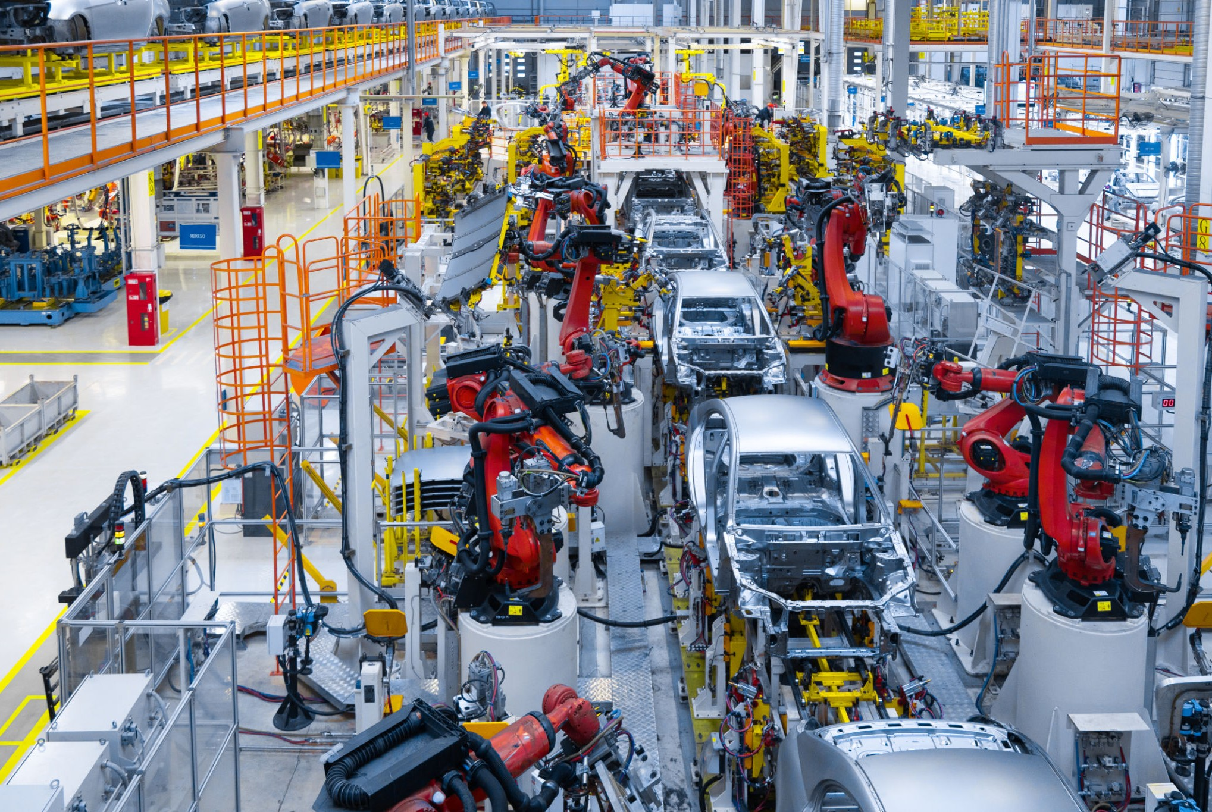
Case Study — Tesla Gigafactory Automation
Overview
Tesla's Shanghai Gigafactory produces one Model Y every 30 seconds.
Robotics & Control
• 1,500+ KUKA and FANUC robots
• Siemens PLCs + Tesla SCADA (99.9% uptime)
65%
10
15,000
30s
Production Cost Reduction
Defects per 100 Vehicles
Employees + Robots
Per Car Production Time
Key Takeaway: Successful automation combines CCS strengths with human strengths (judgment, adaptability)
26

Slide 27
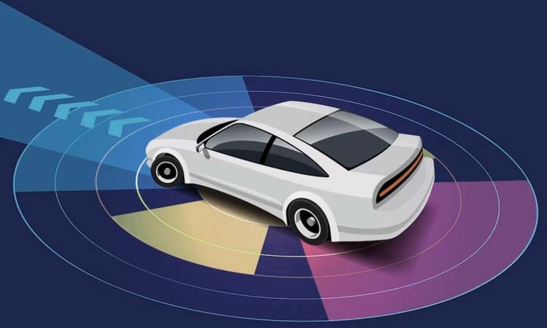
Case Study — Waymo Autonomous Taxi Service
Overview
Waymo operates the world's largest robotaxi fleet.
Technology & Scale (2024)
• LIDAR + cameras + RADAR sensor fusion
• 700+ vehicles, 100,000+ paid rides/week
• 20+ million autonomous miles driven
85%
$15-20
0
2025
Fewer Injury Crashes vs Humans
Per Ride (Competitive with Uber)
At-Fault Fatalities
Profitability Target Year
Challenges
• Limited to mapped/geofenced areas • Struggles with heavy rain/snow • Regulatory hurdles • Public acceptance still growing
27

Slide 28
The Future is Collaborative
Computer-controlled systems don't replace humans — they augment our capabilities
Week 11 — Computer Controlled Systems
Lecture 21 & 22
Thank You

